Slide 1

Object Recognition with Neural Networks Using the CIFAR-10 Dataset
For the partial fulfillment of requirements of Module 3 Machine Learning October 2024 B of PGD Certificate in Artificial Intelligence at University of Essex Online.
University Number: 12696230

Slide 2
Executive Summary
Task Overview
The assignment aimed to train a Neural Network using the CIFAR-10 dataset and evaluate its performance, with Python as the programming language. A Convolutional Neural Network (CNN) was chosen due to the context of object recognition. The process encompassed dataset exploration, preprocessing, architecture design, model training, evaluation, and reflections on gained insights.
Problem Statement
Can a CNN effectively train for object recognition using CIFAR-10, and how well does it perform?
Key outcomes
The model achieved 55.22% accuracy and a loss of 1.24, struggling with underrepresented classes like "cat" and "bird" and similar pairs such as airplanes vs. ships (0 vs. 8) and cats vs. frogs (3 vs. 6), showing a need for further optimization.
Iterative model refinement improved stability, and technical skills, with room for improvement.

Slide 3
Agenda
1
Introduction
2
Model Development Workflow
3
Model Optimization and Validation
4
Learning

Slide 4
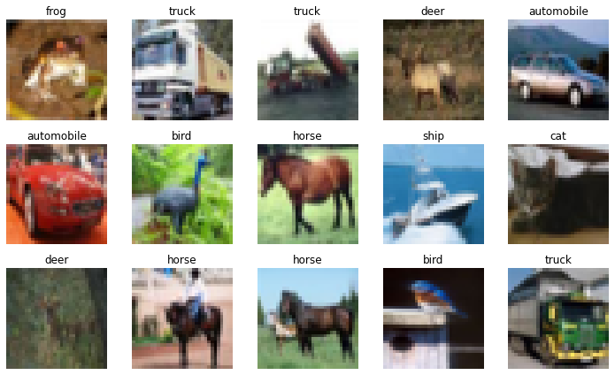
Training a Convolutional Neural Network (CNN) for Object Recognition with CIFAR-10
1
Background and Approach
Analysis
Neural networks learn from data to make decisions, widely used in applications like identifying face and objects, and categorizing image, which all support functionalities in security and social media technologies (Al-Malah, K.I.M. 2024).
Convolutional Neural Networks (CNNs) are deep learning models for structured data like images, producing 3-D outputs called activations. They also apply to text, audio and signals, with their structure tailored to tasks by adjusting layer configurations and quantities (Al-Malah, K.I.M. 2024).
A loss function evaluates neural network performance, with CNN training focused on minimizing this loss (Aceves-Fernandez, M. A. 2020).
The objective is training a CNN for object recognition using CIFAR-10. It included dataset preparation, model design, training, evaluation, and insights.
Sample of Labeled Images
Key message: This assignment will train a CNN, tailored for image data, for object recognition by leveraging its structured design and optimizing performance through loss minimization. The image shows a sample of labeled images from the CIFAR-10 dataset.

Slide 5
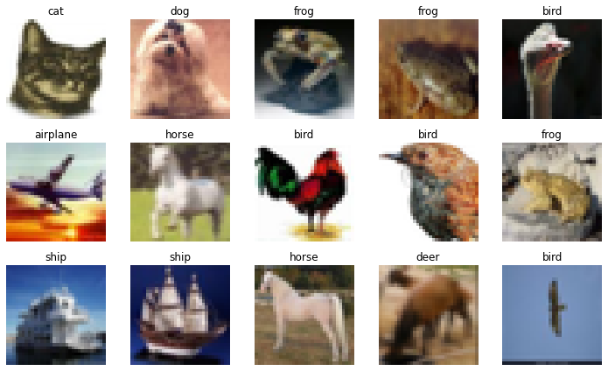
Understanding the CIFAR-10 Dataset and the Split Methodology
1
Background and Approach
Analysis
CIFAR-10 is a popular image dataset containing images and is designed specifically for visual recognition tasks (Mattmann, C. 2021). It's especially appropriate for this task since it's a widely used benchmark and a manageable size.
The dataset consists of 60,000 images, each measuring 32x32 pixels, and categorized into 10 distinct object classes. The classes include airplane, bird, automobile, etc. (Keras (n.d.) ‘CIFAR-10 Dataset API’).
Dataset split methodology: 80% training, 20% temporary, with the temporary set split equally into 10% validation and 10% test sets. The final split is 48,000 for training and 6,000 each for validation and testing.
Using a validation set is essential for tuning hyperparameters, while balancing model complexity and performance to avoid overfitting or underfitting (Witten et al. 2017).

Slide 6
Agenda
1
Introduction
2
Model Development Workflow
3
Model Optimization and Validation
4
Learning

Slide 7
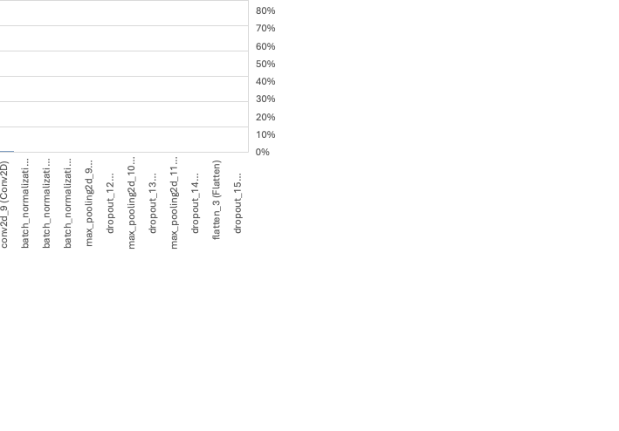
Data Exploration and Neural Network Architecture
2
Background and Approach
Analysis
Dataset Preparation, Visualization: Loaded CIFAR-10, normalized pixel values to [0,1], split data into 80/10/10, and applied one-hot encoding to labels. Displayed a sample image with its label and visualized training set images in a grid for diversity analysis.
Data Analysis: Verified dataset shapes, analyzed class distributions, and ensured data readiness for modeling.
Model Structure: Built a 3-layer model with ReLU activation, each followed by batch normalization and max-pooling, to extract image features and simplify data. Dropout for preventing overfitting, and a final layer for predicting probabilities for 10 categories.
Training Setup: Configured the model with an Adam efficient optimizer, categorical cross entropy loss function for multi-class predictions, and accuracy tracking.
Data Understanding and Model Summary: A function visualized images with labels and summarized the model's design, highlighting its key components and overall complexity.
Key message: The parameter distribution highlights that computational complexity is concentrated in Dense and Conv2D layers for feature learning and predictions; while pooling and dropout layers ensure efficiency and prevent overfitting.

Slide 8
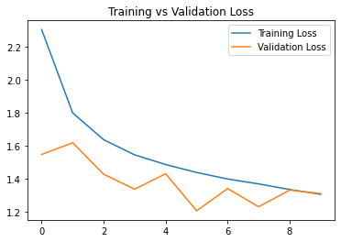
Improving Robustness and Generalization with Augmentation
2
Background and Approach
Analysis
Data Augmentation: Rotations, shifts, flips, zooms, and shearing were applied to the training data to increase diversity and strengthen the ability to handle new and unfamiliar inputs.
Training Setup: The model was trained on the augmented dataset with a batch size of 64 images for up to 35 epochs, using validation data for performance monitoring.
Overfitting Control: Early stopping and model checkpointing were employed to halt training when validation loss stopped improving and restore the weights of the best-performing epoch, ensuring both generalization and reliability.
Generalization Strategy: Combined augmentation and early stopping ensured the model could learn effectively from diverse data while avoiding overfitting, leading to better predictions on new images.
Key message: Using data augmentation and early stopping with checkpointing, the model effectively generalized while minimizing overfitting. The graph shows both losses decreasing in tandem, indicating a well-trained model with robust performance on unseen data.

Slide 9
Agenda
1
Introduction
2
Model Development Workflow
3
Model Optimization and Validation
4
Learning

Slide 10
From Metrics to Visuals: Understanding Model Behavior
3
Background and Approach
Analysis
Model Evaluation: Assessed final performance using test loss (error on unseen data) and test accuracy (percentage of correct predictions) on an independent dataset.
.
Predictions, Metrics, and Analysis: Generated predictions, converted labels, created a classification report with precision, recall, and F1-scores, and used a confusion matrix to visualize correct and incorrect predictions, highlighting strengths and weaknesses in class-specific performance.
Data Verification: Confirmed the test data's compatibility with the model by validating dataset shapes to ensure reliability.
Result Visualization: Classes like ship, automobile, and horse performed better, with relatively higher metrics, while bird, cat, and dog performed worse (lower F1-scores), highlighting difficulty in differentiation.
Key message: The model achieves 55% accuracy, performing slightly better than chance across all classes on average, but struggles with underrepresented and difficult classes like "cat" and "bird," highlighting the need for optimization.

Slide 11
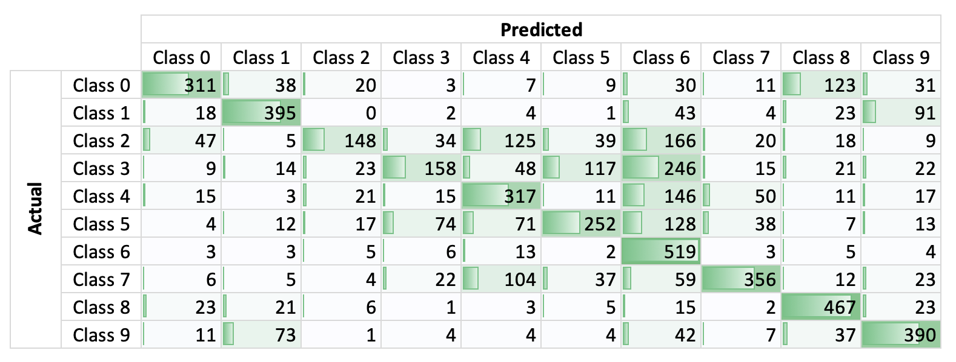
Performance Overview: Consistent Accuracy with Notable Misclassifications in Similar Classes
3
Background and Approach
Analysis
Test Accuracy and Loss: The test accuracy of 55.22% and loss of 1.24 are consistent with the validation trends, where accuracy stabilizes around 55% and loss near 1.2. This consistency suggests the model generalizes well across the training, validation, and test datasets, indicating stable performance.
Benchmark Comparison: Compared to a possible state-of-the-art 90-99% accuracy, this model is underperforming.
Confusion Matrix: The model predicts Class 6 and Class 8 (frog and ship) accurately. However, it struggles with categories that exhibit high inter-class similarity, such as Class 0 (airplane) and Class 8 (ship) or Class 3 (cat) and Class 6 (frog).
Possible Explanation: These challenges arise most likely due to similar visual characteristics or contextual similarities.
Confusion Matrix
Key message: The model achieves 55.22% accuracy and 1.24 loss, with challenges in distinguishing similar classes like airplanes and ships – classes 0 vs. 8 (123) as well as cat and frog – classes 3 vs. 6 (246).

Slide 12
Agenda
1
Introduction
2
Model Development Workflow
3
Model Optimization and Validation
4
Learning

Slide 13
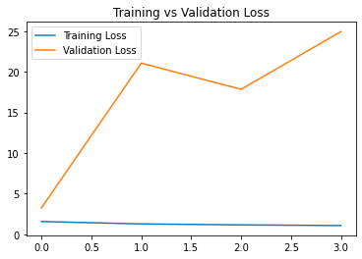
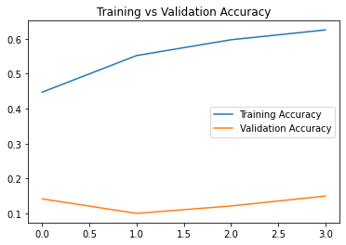
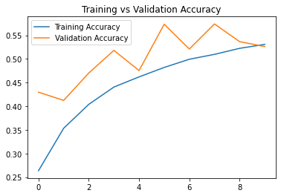
Refining The Model: Tackling Overfitting with Data Split Adjustments, Simplified Architecture, and Targeted Enhancements
4
Background and Approach
Analysis
Initial Challenges: Overfitting and poor validation accuracy were caused by an incorrect 70/20/10 split, excessive 50 epochs, and a simple model. Early fixes like dropout and BatchNormalization worsened overfitting.
Data Split Correction: Adjusting the data split to 80/10/10 resolved the imbalance, providing a solid foundation for training and evaluation.
Hyperparameter Tuning: Reduced the learning rate to 0.0003–0.0004, increased early stopping patience to 5–7 epochs, used the Adam optimizer, and set random seeds for reproducibility.
Final Refinements: Reverted to a batch size of 64, capped training at 35 epochs, introduced data augmentation, and simplified Conv2D and Dense layers, improving generalization and performance.
Previous Poor Results
Optimized Final Results
Key message: By addressing data splitting, hyperparameters, and model architecture, the final approach significantly enhanced model stability, usability, and generalization to unseen data - with room for improvement.

Slide 14
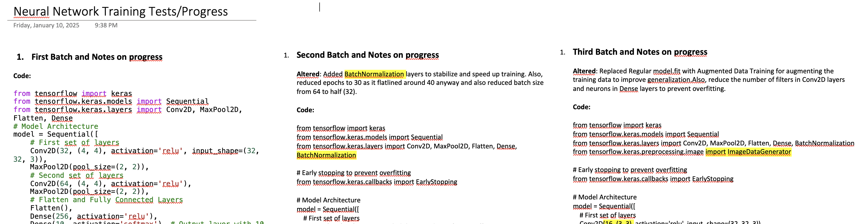
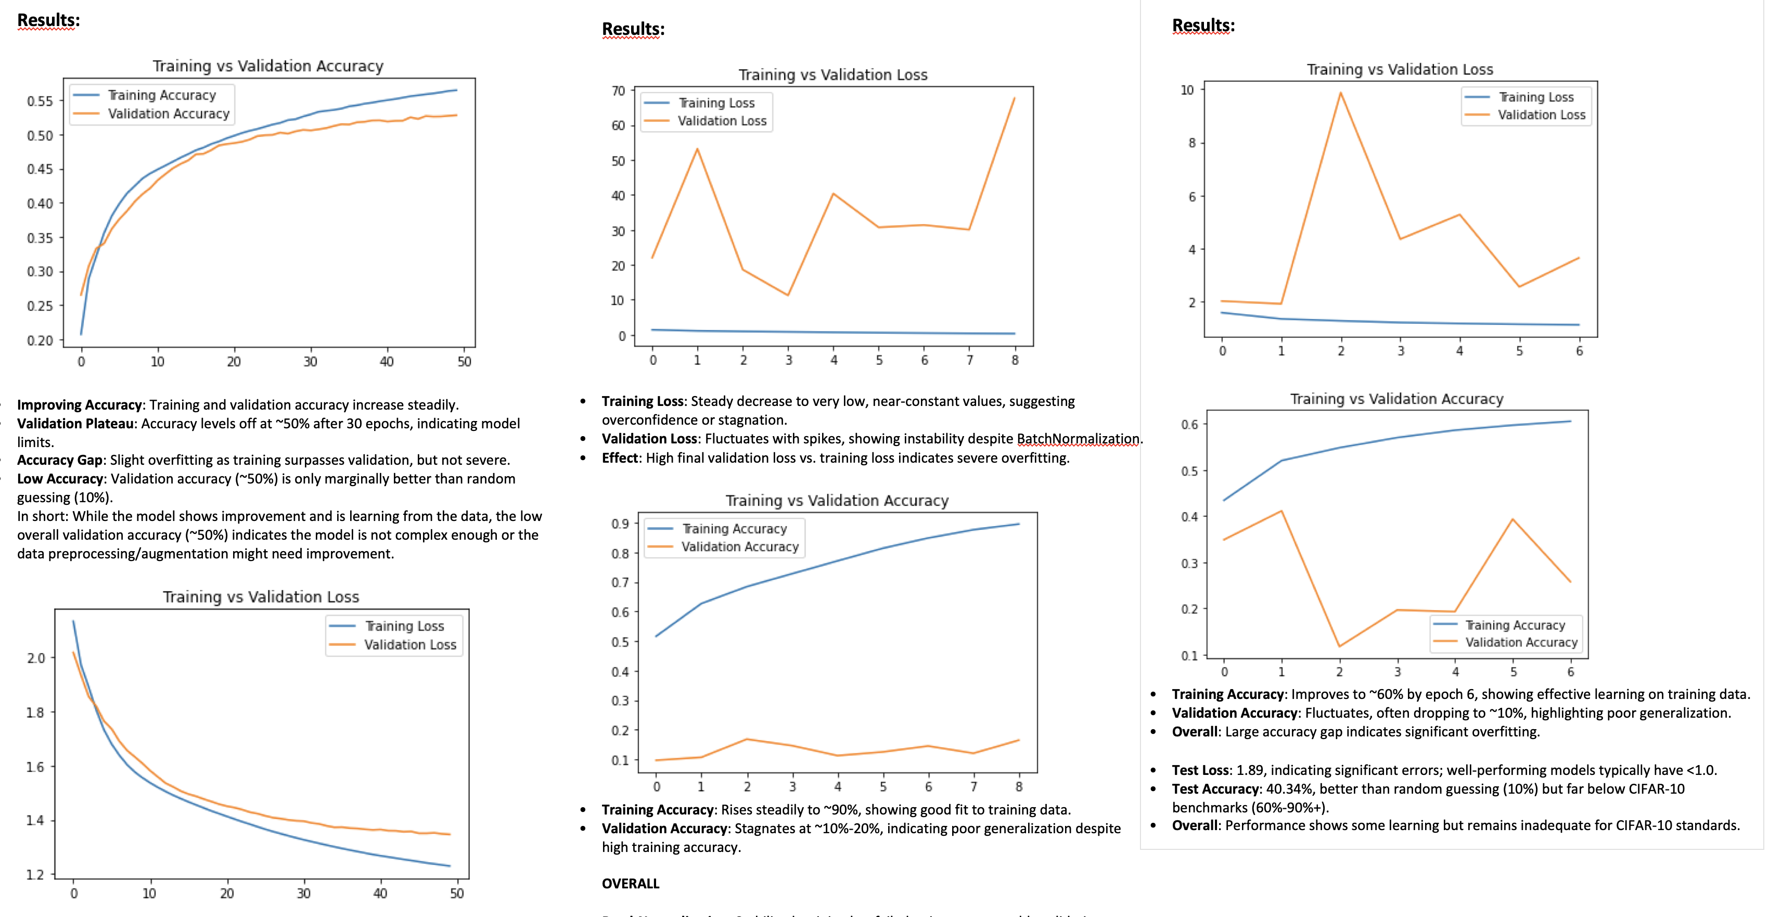
Learnings and Conclusion
4
Background and Approach
Analysis
Skill Development: Significant growth in Python programming skills, despite early challenges with errors like an incorrect test split (70/20/10 instead of 80/10/10).
Debugging and Reproducibility: Debugging played a crucial role in resolving issues, ensuring reproducibility with random seeds, and stabilizing the model through hyperparameter tuning.
Model Refinement: Iterative refinements, including early stopping and batch size adjustments, enhanced model usability and provided insights into neural network design and optimization.
Future Directions: Potential next steps might include using larger datasets such as the CIFAR 100 or exploring advanced architectures and features to further improve performance.
Notes from Model Training Progress
Key message: Correcting initial errors and iteratively refining the model improved Python programming skills, leading to enhanced model stability. Potential future improvements might use a larger datasets (CIFAR-100) and explore advanced neural network architectures.

Slide 15
Appendix: References
5
Books and Edited Volumes:
Aceves-Fernandez, M.A. (ed.) (2020) Advances and Applications in Deep Learning. London: IntechOpen.
Al-Malah, K.I.M. (2024) Machine and Deep Learning Using MATLAB: Algorithms and Tools for Scientists and Engineers. 1st edn. Hoboken, NJ: John Wiley & Sons.
Chi Leung Hui, P. (2023) Artificial Neural Networks: Recent Advances, New Perspectives and Applications. Available at: https://www.intechopen.com (Accessed: 16 January 2025).
Mattmann, C. (2021) Machine Learning with TensorFlow. 2nd edn. New York: Manning Publications Co. LLC.
Witten, I.H., Frank, E., Hall, M.A., and Pal, C.J. (2017) Data Mining: Practical Machine Learning Tools and Techniques. 4th edn. Cambridge, MA: Morgan Kaufmann.
Articles:
Jordan, K. (2024) ‘94% on CIFAR-10 in 3.29 Seconds on a Single GPU’, arXiv preprint. Available at: https://arxiv.org/abs/2404.00498 (Accessed: 16 January 2025).
Websites:
Papers with Code (n.d.) ‘Comparison Benchmarks: Image Classification on CIFAR-10’. Available at: https://paperswithcode.com/sota/image-classification-on-cifar-10? (Accessed: 12 January 2025).
Scikit-learn (n.d.) ‘Supervised Neural Networks’. Available at: https://scikit-learn.org/1.5/modules/neural_networks_supervised.html (Accessed: 10 January 2025).
TensorFlow (n.d.) ‘Beginner Quickstart’. Available at: https://www.tensorflow.org/tutorials/quickstart/beginner (Accessed: 08 January 2025).
Kaggle (n.d.) ‘CIFAR-10 Basic CNN with PyTorch’. Available at: https://www.kaggle.com/code/icofield/cifar-10-basic-cnn-with-pytorch (Accessed: 28 December 2024).
Kaggle (n.d.) ‘CIFAR-Conv’. Available at: https://www.kaggle.com/code/cvvcvccvvcvc/cifar-conv (Accessed: 21 December 2024).
Keras (n.d.) ‘CIFAR-10 Dataset API’. Available at: https://keras.io/api/datasets/cifar10/ (Accessed: 21 December 2024).

